Slide 1
Kaggle Movie Reviews Sentiment Analysis
Bryan D’amico, Matthew Smith and Sintia Stabel

Slide 2
Traditional NLTK Analysis
Attempt to classify the sentiment of the reviews by creating feature sets to train the NLTK Naïve Bayes classifier on
Data Processing
Extract unique full reviews from Kaggle data set
Create two new sets of reviews
Reviews with original sentiment labels (0-4)
Reviews with modified sentiment labels (1-3)
Tokenization
Lower-case
Lemmatization
Randomization in preparation for training and testing

Slide 3
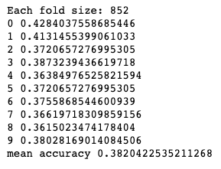
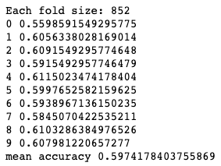
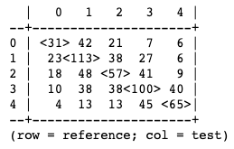
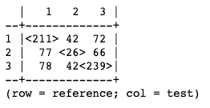
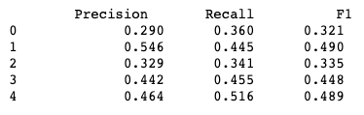

Experiment 1: Bag of Words
Features: Identifying presence or absence of 2000 most common word tokens
Five Sentiment Reviews
Three Sentiment Reviews
Single Evaluation
Confusion Matrix
10-fold Cross Validation
Single Evaluation
Confusion Matrix
10-fold Cross Validation
Additional Metrics
Additional Metrics
Just using the bag of word feature sets was not informative enough for the classifier. Many mistakes were made when trying
to classify the negative and neutral reviews. Overall, classifier performance was not sufficient.

Slide 4
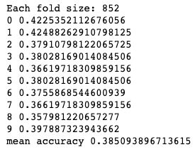
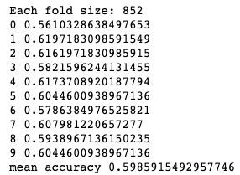
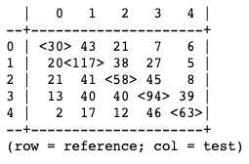
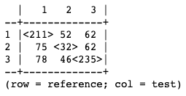
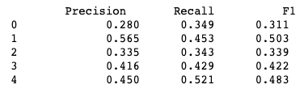

Experiment 2: Bag of Words and Length
Features: Identifying presence or absence of 2000 most common word tokens and length of review measured by number of characters
Five Sentiment Reviews
Three Sentiment Reviews
Single Evaluation
Confusion Matrix
10-fold Cross Validation
Single Evaluation
Confusion Matrix
10-fold Cross Validation
Additional Metrics
Additional Metrics
The classifier did not find length to be a particularly informative feature. The performance of the classifier is almost identical to
the results of the previous experiment.

Slide 5
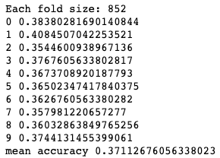
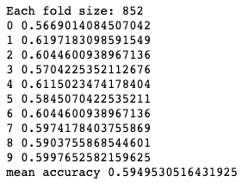
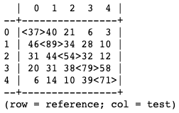
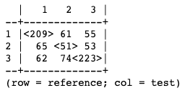
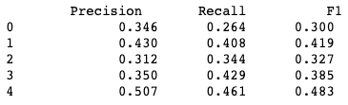

Experiment 3: Common Negation Words
Features: Identifying presence or absence of 2000 most common word tokens and indication of word being negative through presence of negation word
Five Sentiment Reviews
Three Sentiment Reviews
Single Evaluation
Confusion Matrix
10-fold Cross Validation
Single Evaluation
Confusion Matrix
10-fold Cross Validation
Additional Metrics
Additional Metrics
Negation features did not help the classifier understand the sentiments of the reviews better. The accuracy for the five
sentiment reviews saw a slight decrease. Still having most trouble with neutral reviews.

Slide 6
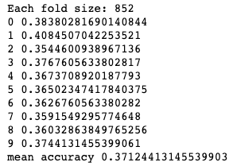
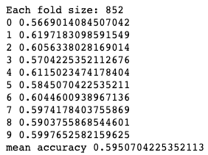
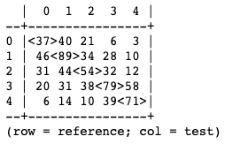
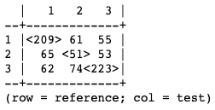
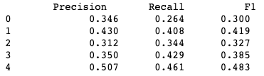

Experiment 4: Extended Negation Words
Features: Identifying presence or absence of 2000 most common word tokens and indication of word being negative through presence of negation word using an extended list
Five Sentiment Reviews
Three Sentiment Reviews
Single Evaluation
Confusion Matrix
10-fold Cross Validation
Single Evaluation
Confusion Matrix
10-fold Cross Validation
Additional Metrics
Additional Metrics
Identical confusion matrices when compared to the previous experiment indicate that the classifier did not make use of
the additional negation words. Performance of the classifier was unchanged.

Slide 7
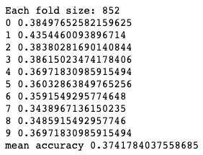
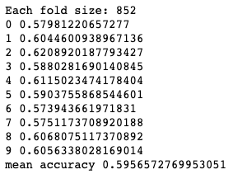
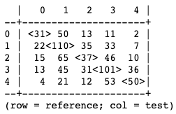
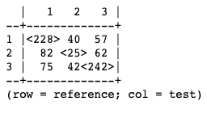
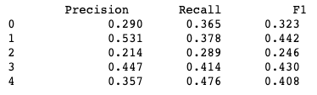

Experiment 5: Removing Stopwords
Features: Identifying presence or absence of 2000 most common word tokens excluding NLTK stopwords
Five Sentiment Reviews
Three Sentiment Reviews
Single Evaluation
Confusion Matrix
10-fold Cross Validation
Single Evaluation
Confusion Matrix
10-fold Cross Validation
Additional Metrics
Additional Metrics
Focusing on the content words of the reviews did not improve performance. Classifier especially struggled with
neutral reviews. Greater disparity between accuracies during cross validations.

Slide 8
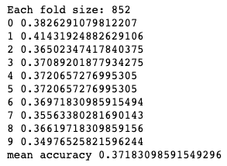
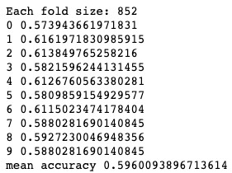
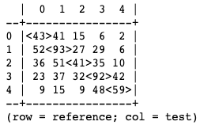
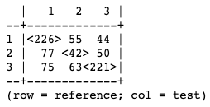
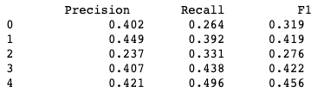

Experiment 6: Extended Negation Words and Removing Stopwords
Features: Identifying presence or absence of 2000 most common word tokens excluding NLTK stopwords and indication of word being negative through presence of negation word using an extended list
Five Sentiment Reviews
Three Sentiment Reviews
Single Evaluation
Confusion Matrix
10-fold Cross Validation
Single Evaluation
Confusion Matrix
10-fold Cross Validation
Additional Metrics
Additional Metrics
Combining the feature sets of experiments 4 and 5 did not make the classifier more informed through the training process.
Classifier still displays the same weaknesses, especially regarding the neutral sentiment.

Slide 9
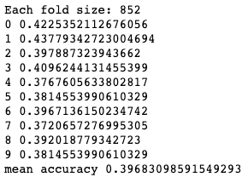
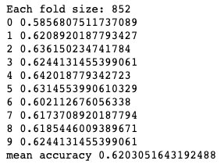
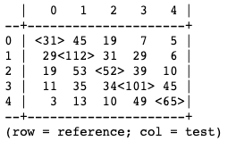
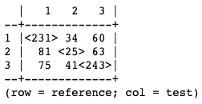
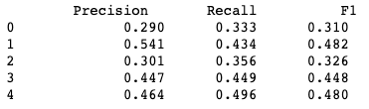

Experiment 7: Word Subjectivity
Features: Identifying presence or absence of 2000 most common word tokens along with positive and negative ratings based on words identified in the subjectivity lexicon
Five Sentiment Reviews
Three Sentiment Reviews
Single Evaluation
Confusion Matrix
10-fold Cross Validation
Single Evaluation
Confusion Matrix
10-fold Cross Validation
Additional Metrics
Additional Metrics
Performance of the classifier on the five sentiment reviews was similar to other experiments. Performance on the three
sentiment reviews showed slight improvement, despite even more issues with neutral reviews.

Slide 10
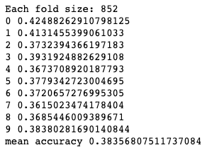
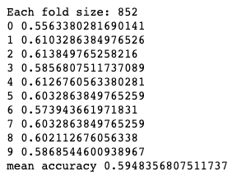
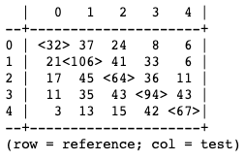
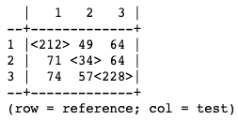
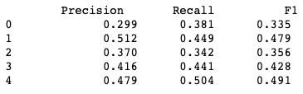

Experiment 8: Parts of Speech
Features: Identifying presence or absence of 2000 most common word tokens along with counts of nouns, verbs, adjectives, and adverbs
Five Sentiment Reviews
Three Sentiment Reviews
Single Evaluation
Confusion Matrix
10-fold Cross Validation
Single Evaluation
Confusion Matrix
10-fold Cross Validation
Additional Metrics
Additional Metrics
Similar performance to all other classifiers, besides word subjectivity. When applied to five sentiment reviews, better
performance with neutral reviews, although worse with negative reviews. Performance against three sentiment reviews still
highlights weakness in relation to neutral reviews.

Slide 11

Experiment 9: TextBlob Sentiment Analysis
TextBlob package converts strings to blob objects
Contain many pieces of information such as parts of speech tags and phrases, subjectivity and polarity scores
No processing required
Raw text strings are given to the TextBlob conversion function
TextBlob sentiment scores were compared to three sentiment labels
TextBlob score greater than 0.05 and positive sentiment is a match
TextBlob score between -0.05 and 0.05 and neutral sentiment is a match
TextBlob score less than -0.05 and negative sentiment is a match
Number of matches determined “accuracy”
Surprised to find match accuracy was the same as Naïve Bayes classifiers accuracies

Slide 12
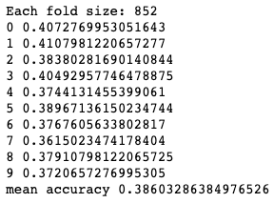
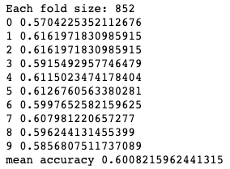
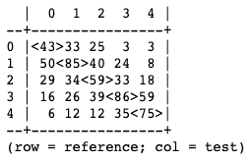
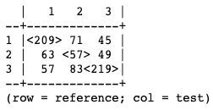


Experiment 10: Multiple Feature Sets
Features: Bag of Words + Extended Negation Words + Part of Speech Tags + Word Subjectivity
Five Sentiment Reviews
Three Sentiment Reviews
Single Evaluation
Confusion Matrix
10-fold Cross Validation
Single Evaluation
Confusion Matrix
10-fold Cross Validation
Additional Metrics
Additional Metrics
Quantity does not equal quality. More features did not result in a more informed classifier. Performance was roughly equal
to any of the classifiers using one of the feature sets. Slight improvement in dealing with neutral reviews.

Slide 13
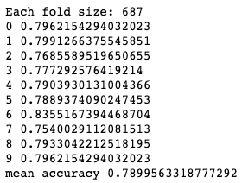
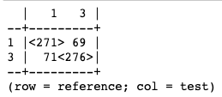

Experiment 11: Two Sentiment Analysis
Want to see performance when weakest aspect removed
Three sentiment review data was filtered to remove all neutral reviews
Full data processing applied
Tokenization, lower case, lemmatization
Applied best performing classifier – word subjectivity features
Classifier performed much better
Single Evaluation
Confusion Matrix
10-fold Cross Validation
Additional Metrics

Slide 14
NLTK Analysis Conclusions
Feature sets did not provide informative enough training data for the Naïve Bayes classifier to handle this task
These methods may not be equipped to handle analyses with several sentiments
Five sentiment review performance was always quite poor
Even a pre-trained model had low accuracy
Potential issue with the way the reviews were tagged
Even humans will disagree on sentiment (somewhat positive vs. positive)
Best suited for a binary classification
Removing neutral reviews showed large performance gains

Slide 15
Data preparation
Lowercase
# Convert text to lowercase
def preprocess_text(text):
text = text.lower()
Punctuation
# Remove special characters and punctuation
text = re.sub(r'[^\w\s]', '', text)
Stopwords
# Remove stopwords
stop_words = set(stopwords.words('english'))
tokens = [token for token in tokens if token not in stop_words]
Lematization
# Lemmatize the tokens
lemmatizer = WordNetLemmatizer()
tokens = [lemmatizer.lemmatize(token) for token in tokens]
Notes:
Prior to running additional tests and models with our Movie Reviews dataset, we performed some pre-processing techniques that we believe would improve the model's ability to classify the sentiment of the movie reviews.
The column containing the reviews was converted to lowercase, and punctuations as well as special characters were removed. Additionally, we used nltk’s stop-words module to remove common words that don’t add meaning and don’t help with our task. We also performed lemmatization, as we believed this would improve the model’s ability to perform the classification as it increases consistency and reduces dimensionally by reducing the overall number of unique words.

Slide 16
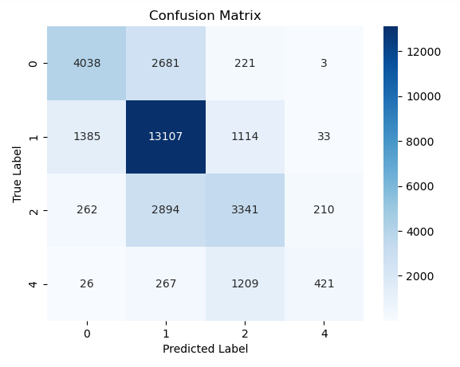
SVM – SVC linear Classifier
Sklearn TfidfVectorizer - feature extraction
Accuracy: 66.98%
# Define the TF-IDF vectorizer
vectorizer = TfidfVectorizer()
# Transform the text data
train_x = vectorizer.fit_transform(train_df['processed_text'])
test_x = vectorizer.transform(test_df['processed_text'])
# Define the labels
train_y = train_df['Sentiment']
test_y = test_df['Sentiment']
# Train the SVM classifier
classifier = svm.SVC(kernel='linear')
classifier.fit(train_x, train_y)
Notes:
A Support Vector Machine with a linear kernel was used to classify our data. The data was divited into 80-20 train test splits. It also used the TF-IDF vectorizer to transform the text into a format that the SVM can understand.
The TF_IDF stands for "Term Frequency-Inverse Document Frequency“. It’s essentially a numerical statistic that is widely used in data retrieval and text mining, which aims to highlight terms that are both frequent and rare within a document collection.
TF-IDF is calculated based on two main components: term frequency (TF) and inverse document frequency (IDF)
TF = (Number of occurrences of a term in a document) / (Total number of terms in the document)
IDF = log((Total number of documents in the collection) / (Number of documents containing the term))
TF-IDF = TF * IDF
Without getting too deep into the math,
The resulting TF-IDF score reflects the importance of a term within a specific document in relation to the entire collection of documents. Higher values indicate that the term is more significant to the document.
Overall, this run of the model produced a classification accuracy of 66.98 with labels 1,0 and 2 performing best as shown in the confusion matrix heatmap.

Slide 17
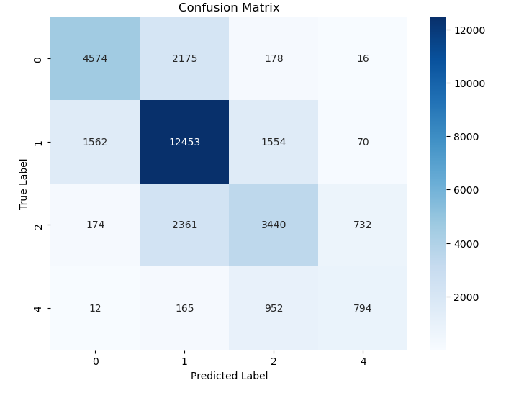
Random forest – Sklearn Ensemble Classifier
Sklearn TfidfVectorizer - feature extraction
Accuracy: 68.12%
# Define the TF-IDF vectorizer
vectorizer = TfidfVectorizer()
# Transform the text data
train_x = vectorizer.fit_transform(train_df['processed_text'])
test_x = vectorizer.transform(test_df['processed_text'])
# Define the labels
train_y = train_df['Sentiment']
test_y = test_df['Sentiment’]
# Train the Random Forest classifier
classifier = RandomForestClassifier(n_estimators=100, random_state=42)
classifier.fit(train_x, train_y)
Notes:
The same pre-processing and feature extraction methods were used while using the Random Forest model. . The concept behind Random Forest is to create an ensemble of decision trees, where each tree is trained on a random subset of the training data and uses a random subset of features. This randomness injects diversity into the individual trees, reducing the risk of overfitting and improving the model's generalization.
The strength of Random Forest lies in its ability to handle complex relationships between features and class labels while mitigating the risk of overfitting. By aggregating predictions from multiple decision trees, the ensemble method reduces the impact of individual trees' biases and errors, leading to more robust and accurate sentiment analysis results.
Overall, model delivered an accuracy score of 68.12%. The heatmap plot shows that labels 1, 0 and 2 had the highest rates of accuracy, while 4 had the worst.
It should be noted that all of these models took several hours to run, so any modifications would have been difficult to implement.

Slide 18
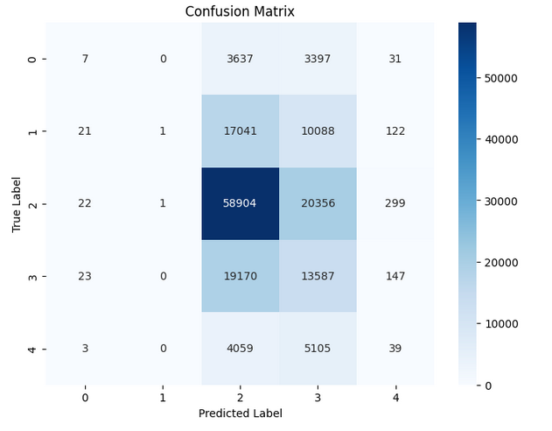
Hugging Face – Bert Sentiment Analysis
Accuracy 46.48%
# Instantiate the tokenizer and sentiment analysis model
tokenize = BertTokenizer.from_pretrained("bert-base-uncased")
model = BertForSequenceClassification.from_pretrained("bert-base-uncased", num_labels=4)
# Create input tensors
inputs = {
"input_ids": torch.tensor([input_ids]),
"attention_mask": torch.tensor([[1] * len(input_ids)]) }
# Perform sentiment analysis
outputs = model(**inputs)
logits = outputs.logits
predicted_label = torch.argmax(logits).item()
predicted_sentiments.append(predicted_label)
Notes:
In the spirit of learning more about other techniques available, we looked into the Hugging Face’s BERT model. BERT, short for Bidirectional Encoder Representations from Transformers, is a transformer-based model introduced by Google in 2018. It is designed to learn contextual representations of words and sentences by leveraging bidirectional training on a large corpus of text data.
The key innovation of BERT lies in its ability to capture the contextual information of words by considering the entire surrounding context. Unlike traditional models that process words sequentially, BERT uses a transformer architecture, which allows for parallel processing and capturing dependencies among words in both directions.
BERT is pre-trained using two unsupervised learning tasks:
Masked Language Modeling (MLM): In this task, input sentences are randomly masked, and the model is trained to predict the masked words based on the surrounding context. By learning to fill in the masked words, BERT gains a deep understanding of the relationships between words in a sentence.
Next Sentence Prediction (NSP): BERT also learns to predict whether two input sentences appear consecutively or are randomly sampled from different parts of the corpus. This enables the model to capture sentence-level relationships and understand the flow of information between sentences.
You must be asking yourselves – with such a powerful model, why is the performance so low? The most obvious reason is that this mode was run without any pre-processing and also the size of our dataset is probably the main reason as these models are usually trained in much larger datasets.

Slide 19
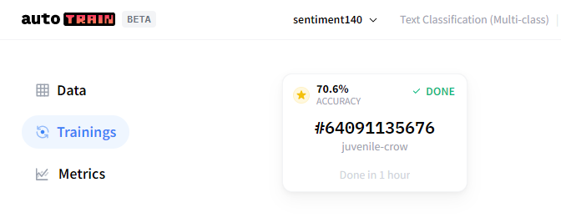

Hugging face – Auto Train BETA
Notes:
We performed one more run, this time the data was cleaned: everything lowercase, special characters and stop words were removed. Lemmatization was also performed.
Surprisingly, the results were worse than before. One explanation could be that the loss of stop words and the lemmatization of words back to their root form caused the model to lose some of its ability properly classify the sentiment of our sample data. It makes sense that this happened because these models take context into consideration. It relies on self attention, which is a key innovation allowing the model to focus on different parts of the input sequence – the model is able to capture dependencies between words in a sentence assigning weights in each.
By changing the formatting of our data, we hindered its ability to detect things such as ! and “ ” which are often used to convey meaning and feelings. It may have had difficulty telling where the sentence started or ended. Lemmatization reduced words to their root causing them to lose contextual meaning as well.

Slide 20


Hugging face – Auto Train Pre-Processed
Notes:
We also experimented with something called Auto NLP which is a machine learning tool that allows you to train your model without code. You basically upload your dataset and select the parameters such as the target variable and whether or not the data would require binary or multi-class classification. In our case we selected the Sentiment to be the target var and multi-class since the sentiment is classified into 5 different levels ranging from negative, neutral to negative.
It was all fine and good, but the prices range wildly. This is not a free service, but we were curious to see how much better the transformer architecture would work with our data compared to our SVM and Ensemble models.
There was also another catch, we could only upload 3000 rows of data.
We then selected a pre-trained model called “Sentiment140”. This model was trained to identify sentiment in 1.6 million tweets. We ran our sample data against this model and the results were slightly better than everything we had so far. Which speaks to the capabilities of these types of models. It this with unprocessed and limited data.

Slide 21
Conclusions - Additional Models
SVM and Random Forest produced similar accuracy results 63-68% accuracy
NLP Models take a long time to train and consume a lot of computing power
NLP Models require massive amounts of data to be trained properly
Data pre-processing is not helpful in every situation – Transformer architecture being a prime example
Architectures like BERT and Auto NLP do not benefit from lemmatization, special character removal, and stop word removal because they play a role in context

Slide 22
Word Embeddings
Using the `gensim` package to extract word embeddings.
Can determine which words have similar context or meaning with others in a body of text.
In this case, we show how bigrams of words show similar word embedding vectors with one another.
Notes:
We performed one more run, this time the data was cleaned: everything lowercase, special characters and stop words were removed. Lemmatization was also performed.
Surprisingly, the results were worse than before. One explanation could be that the loss of stop words and the lemmatization of words back to their root form caused the model to lose some of its ability properly classify the sentiment of our sample data. It makes sense that this happened because these models take context into consideration. It relies on self attention, which is a key innovation allowing the model to focus on different parts of the input sequence – the model is able to capture dependencies between words in a sentence assigning weights in each.
By changing the formatting of our data, we hindered its ability to detect things such as ! and “ ” which are often used to convey meaning and feelings. It may have had difficulty telling where the sentence started or ended. Lemmatization reduced words to their root causing them to lose contextual meaning as well.

Slide 23

Edge weight = the importance, frequency, or probability of transitioning to one work to the next in a bigram
Notes:
We performed one more run, this time the data was cleaned: everything lowercase, special characters and stop words were removed. Lemmatization was also performed.
Surprisingly, the results were worse than before. One explanation could be that the loss of stop words and the lemmatization of words back to their root form caused the model to lose some of its ability properly classify the sentiment of our sample data. It makes sense that this happened because these models take context into consideration. It relies on self attention, which is a key innovation allowing the model to focus on different parts of the input sequence – the model is able to capture dependencies between words in a sentence assigning weights in each.
By changing the formatting of our data, we hindered its ability to detect things such as ! and “ ” which are often used to convey meaning and feelings. It may have had difficulty telling where the sentence started or ended. Lemmatization reduced words to their root causing them to lose contextual meaning as well.

Slide 24

Word vectors are vectors/lists of floats that are the result of the ML model capturing the semantic features of the words in context of the training corpus.
Interpreting individual dimensions of a word vector isn't straightforward or intuitive, because these numbers aren't associated with clearly identifiable properties of words.
In this example (for expandability) we chose words that are bigrams with each other (and not) to show to differences in the word vectors.
“Feels” Vector
[-6.7992467e-01 8.9688659e-01 -2.5406939e-01 7.9326826e-01 1.7226592e-01 -1.3030788e+00 7.6043135e-01 2.5170207e+00 -1.5367763e+00 -9.6420509e-01 -2.9269642e-01 -1.5140722e+00 -4.6345305e-01 2.0598622e-01 4.2727703e-01 -3.6553320e-01 9.6964747e-01 -7.7319992e-01 -2.9792199e-01 -1.9511813e+00 4.4024709e-01 6.1488414e-01 1.4786688e+00 -8.4639961e-01 1.0157923e-01 -1.7117431e-03 -9.0585536e-01 -6.9817954e-01 -9.1863269e-01 1.3165778e-01 1.9572090e+00 -9.0508752e-02 2.3910373e-01 -2.2383986e+00 -3.9571920e-01 1.7079108e+00 5.9104568e-01 -1.0500346e+00 -6.9620162e-01 -1.5526249e+00 2.6991202e-02 -1.6042304e+00...]
Notes:
We performed one more run, this time the data was cleaned: everything lowercase, special characters and stop words were removed. Lemmatization was also performed.
Surprisingly, the results were worse than before. One explanation could be that the loss of stop words and the lemmatization of words back to their root form caused the model to lose some of its ability properly classify the sentiment of our sample data. It makes sense that this happened because these models take context into consideration. It relies on self attention, which is a key innovation allowing the model to focus on different parts of the input sequence – the model is able to capture dependencies between words in a sentence assigning weights in each.
By changing the formatting of our data, we hindered its ability to detect things such as ! and “ ” which are often used to convey meaning and feelings. It may have had difficulty telling where the sentence started or ended. Lemmatization reduced words to their root causing them to lose contextual meaning as well.

Slide 25


Slide 26

Experiment 1: Logistic Regression with Word Embeddings
def get_avg_word2vec(sentence_list, vector, generate_missing=False, k=100):
if len(sentence_list)<1:
return np.zeros(k)
if generate_missing:
vectorized = [vector[word] if word in vector else np.random.rand(k) for word in sentence_list]
else:
vectorized = [vector[word] if word in vector else np.zeros(k) for word in sentence_list]
length = len(vectorized)
summed = np.sum(vectorized, axis=0)
averaged = np.divide(summed, length)
return averaged
def get_word2vec_embeddings(vectors, df, generate_missing=False):
embeddings = unique_reviews['Phrase'].apply(lambda x: get_avg_word2vec(x, vectors,
generate_missing=generate_missing))
return list(embeddings)
# First, tokenize the reviews
unique_reviews['Phrase'] = unique_reviews['Phrase'].apply(lambda x: word_tokenize(x))
# Generate the embeddings
embeddings = get_word2vec_embeddings(model.wv, unique_reviews)
# Train Test Split
X_train, X_test, y_train, y_test = train_test_split(embeddings, unique_reviews['Sentiment'],
test_size=0.2, random_state=40)
# Training a Logistic Regression model
model = LogisticRegression()
model.fit(X_train, y_train)
# Predicting
y_pred = model.predict(X_test)
# Evaluate the model
print(classification_report(y_test, y_pred))
Notes:
Precision: the ability of a classifier not to label a negative sample as positive.
It is the ratio of correctly predicted positive observations to the total predicted positives.
High precision relates to the low false-positive rate. It is defined as Precision = TP/(TP+FP) where TP is the number of true positives and FP is the number of false positives.
Recall (Sensitivity): the ability of a classifier to find all the positive instances.
For each class, it is defined as the ratio of true positives to the sum of true positives and false negatives.
It is defined as Recall = TP/(TP+FN) where TP is the number of true positives and FN is the number of false negatives.
F1-score: the weighted average of Precision and Recall.
It tries to find the balance between precision and recall.
It is defined as F1 Score = 2*(Recall * Precision) / (Recall + Precision).
Support: the number of actual occurrences of the class in the specified dataset.
Imbalanced support in the training data may indicate structural weaknesses in the reported scores of the classifier and could indicate the need for stratified sampling or rebalancing.

Slide 27

Experiment 2: Random Forest with Word Embeddings
from sklearn.ensemble import RandomForestClassifier
from sklearn.model_selection import train_test_split
from sklearn.metrics import classification_report
def get_word2vec_embeddings(vectors, clean_questions, generate_missing=False):
embeddings = [get_avg_word2vec(x, vectors, generate_missing=generate_missing) for x in clean_questions]
return embeddings
# Assuming 'model' is your Word2Vec model
embeddings = get_word2vec_embeddings(model.wv, tokenized_sentences)
# Train Test Split
X_train, X_test, y_train, y_test = train_test_split(embeddings, unique_reviews['Sentiment'],
test_size=0.2, random_state=40)
# Convert list of vectors to numpy arrays
X_train = np.array(X_train)
X_test = np.array(X_test)
# Training a Random Forest Classifier model
model = RandomForestClassifier()
model.fit(X_train, y_train)
# Predicting
y_pred = model.predict(X_test)
# Evaluate the model
print(classification_report(y_test, y_pred))
Notes:
Precision: the ability of a classifier not to label a negative sample as positive.
It is the ratio of correctly predicted positive observations to the total predicted positives.
High precision relates to the low false-positive rate. It is defined as Precision = TP/(TP+FP) where TP is the number of true positives and FP is the number of false positives.
Recall (Sensitivity): the ability of a classifier to find all the positive instances.
For each class, it is defined as the ratio of true positives to the sum of true positives and false negatives.
It is defined as Recall = TP/(TP+FN) where TP is the number of true positives and FN is the number of false negatives.
F1-score: the weighted average of Precision and Recall.
It tries to find the balance between precision and recall.
It is defined as F1 Score = 2*(Recall * Precision) / (Recall + Precision).
Support: the number of actual occurrences of the class in the specified dataset.
Imbalanced support in the training data may indicate structural weaknesses in the reported scores of the classifier and could indicate the need for stratified sampling or rebalancing.

Slide 28
Conclusions – Word Embeddings
Best overall accuracy was approx. 32%
Was not able to capture sentiment categories equally; 0, 2, and 4 had inconsistent results.
Model was able to classify text as sentiment category 1 and 3 at an accuracy rate of 36% and 44%, respectively.
Did not use ‘GloVe’ (Global Vectors for Word Representation) model; another word embeddings model developed by Stanford.

Slide 29
Overall Conclusions
Sentiment analysis (and NLP in general), is a complicated and nuanced field with many approaches.
Even a pre-trained models have low accuracy, depending on the data presented to it
Potential issues come with the way that data is tagged/labeled
Even humans will disagree on sentiment (somewhat positive vs. positive)
Best suited for a binary classification (according to our findings)
Removing neutral reviews showed large performance gains
Data pre-processing is not helpful in every situation

